Slide 1

Learn Python Coding in 6 Days
Sunil Kumar Pulsuri

Slide 2

Day – 1

Slide 3
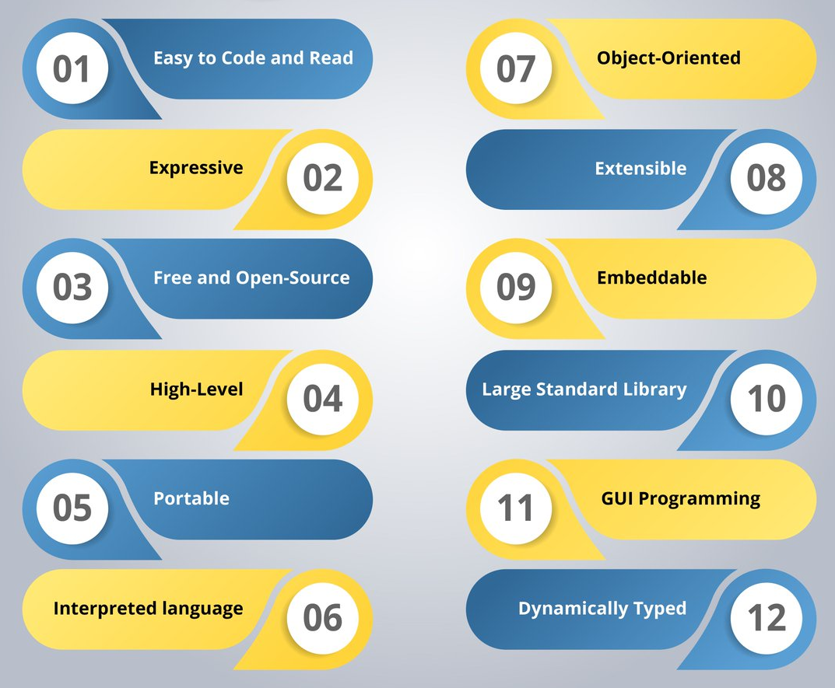

Why Python?

Slide 4
Software Installations:
Python Package:
https://www.python.org/downloads/windows/
PyCharm (For Advanced Users – Require Higher Configuration)
https://www.jetbrains.com/pycharm/download/#section=windows
Download the Community Edition
Thonny IDE:
https://thonny.org/

Slide 5

How to Test Python Is installed or not?
Open Command Prompt
Type: Python or Py
Hit Enter
The Result Should be

Slide 6
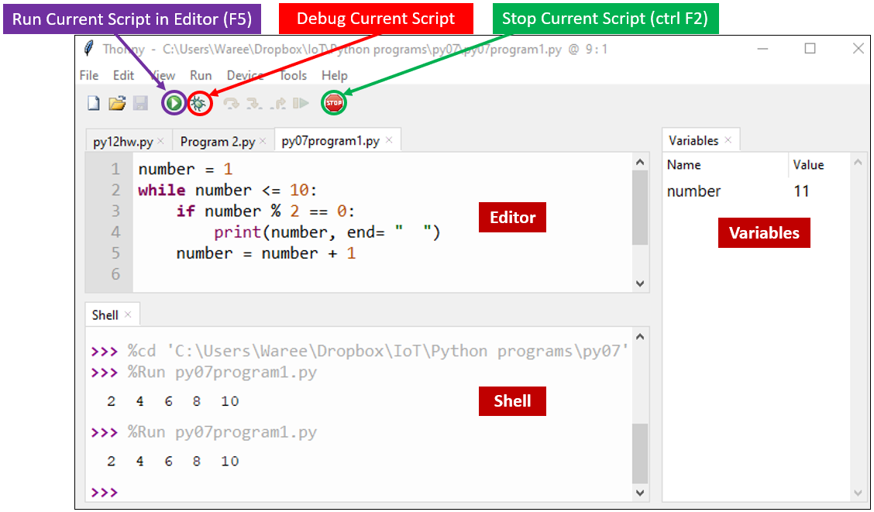
How to Use Thonny?

Slide 7
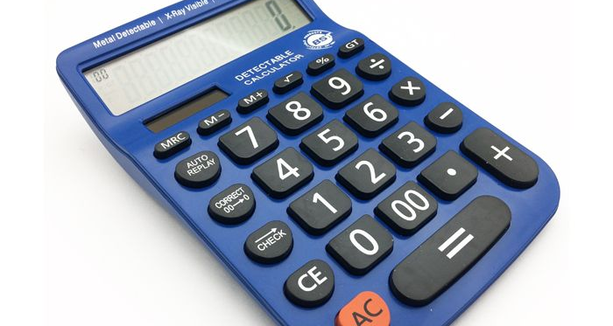
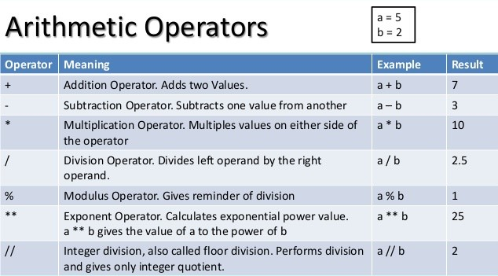
Our First Program – A simple calculator
4 Basic Operations
Addition
Subtraction
Multiplication
Division

Slide 8
What have we learned today?
How to Print a Statement?
Variables
Strings, Int, Float
How to Convert a String to Int or Float
How to assign values from user?
Basic Arithmetic Operations
While loop and If-else Loop

Slide 9
Day – 2

Slide 10
What have we learnt in last lesson?
How to Print a Statement?
Variables
Strings, Int, Float
How to Convert a String to Int or Float
How to assign values from user?
Basic Arithmetic Operations
While loop and If-else Loop

Slide 11
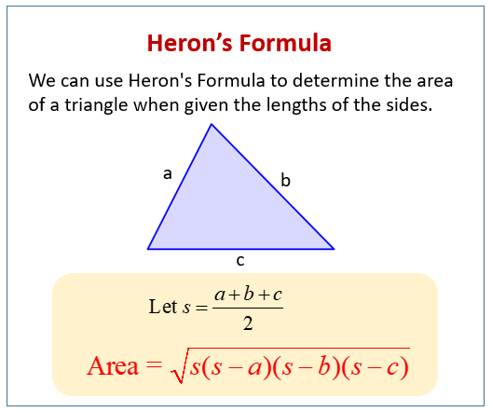
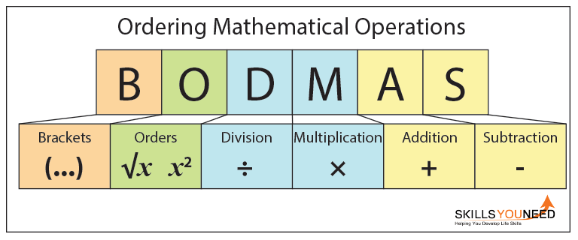
Program – 2: Find the area of a triangle with heron’s formulae
What do we Learn?
Using Mathematical Operations with parenthesis.
S = a + b + c / 2
S = (a + b + c) / 2

Slide 12

Program – 3: Generate a Random Number
Using Libraries
A Python library is a reusable chunk of code that you may want to include in your programs/ projects
We use “random” – Random Library in this program.

Slide 13
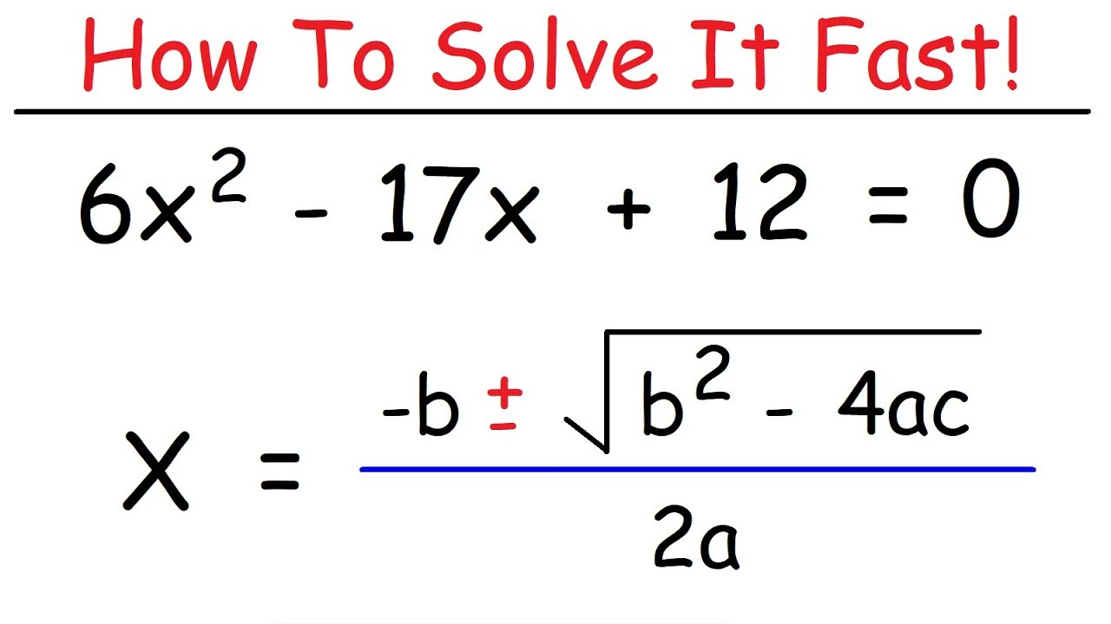
Program – 4: Solving a Quadratic equation
Using Libraries
A Python library is a reusable chunk of code that you may want to include in your programs/ projects
We use “cmath” – Complex Math Library in this program.

Slide 14
Homework task
Design a Program to check whether the speed of the vehicle is in limit, or it is exceeding.
The machine you use will read the speed in Miles. And you must analyse the data in Kilometres.
Speed
Convert it from Miles to Kilometres
1 Mile – 1.6 KM
1 km = 0.62 Miles
If Speed > 60 , Print a command

Slide 15
Day – 3

